Slide 1

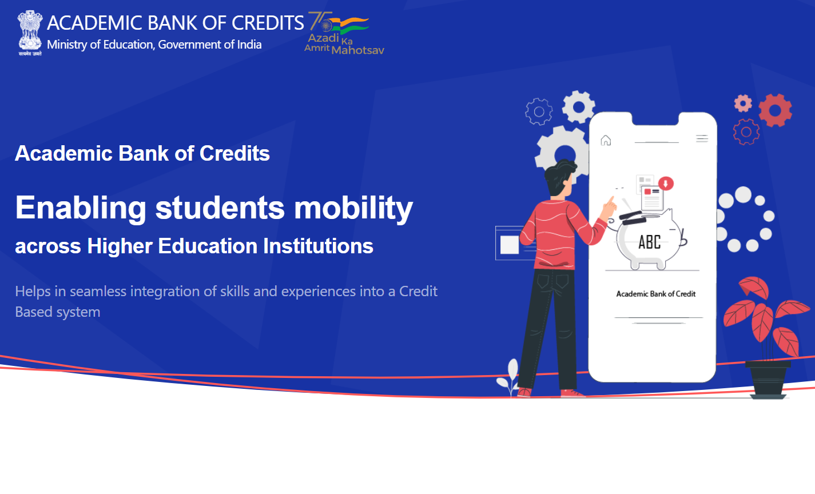
The Controller of Examinations
Vivekananda Global University, Jaipur

Slide 2
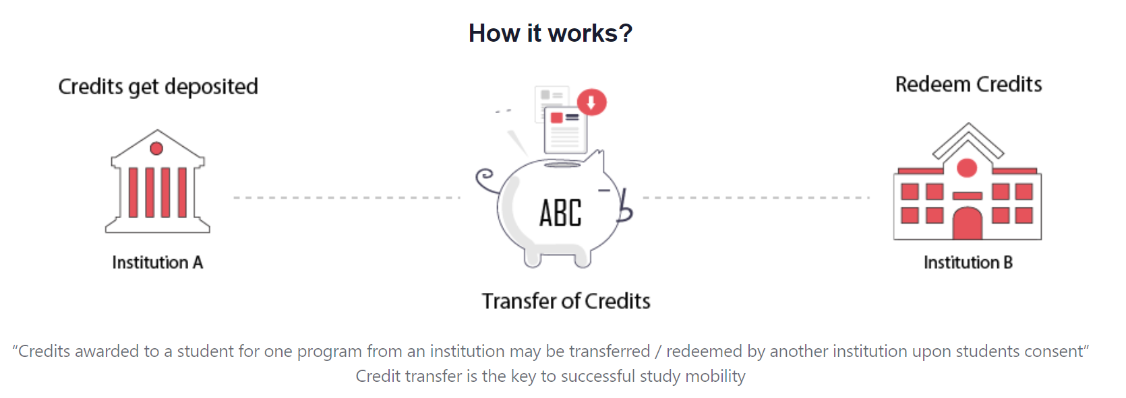
Vivekananda Global University, Jaipur

Slide 3

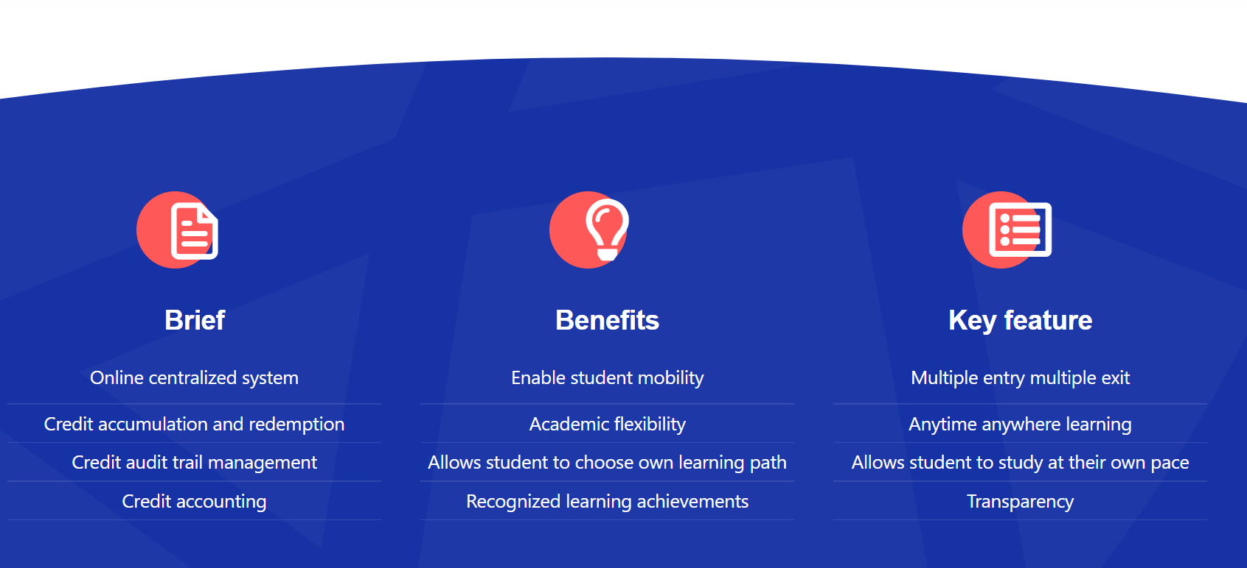
Vivekananda Global University, Jaipur

Slide 4
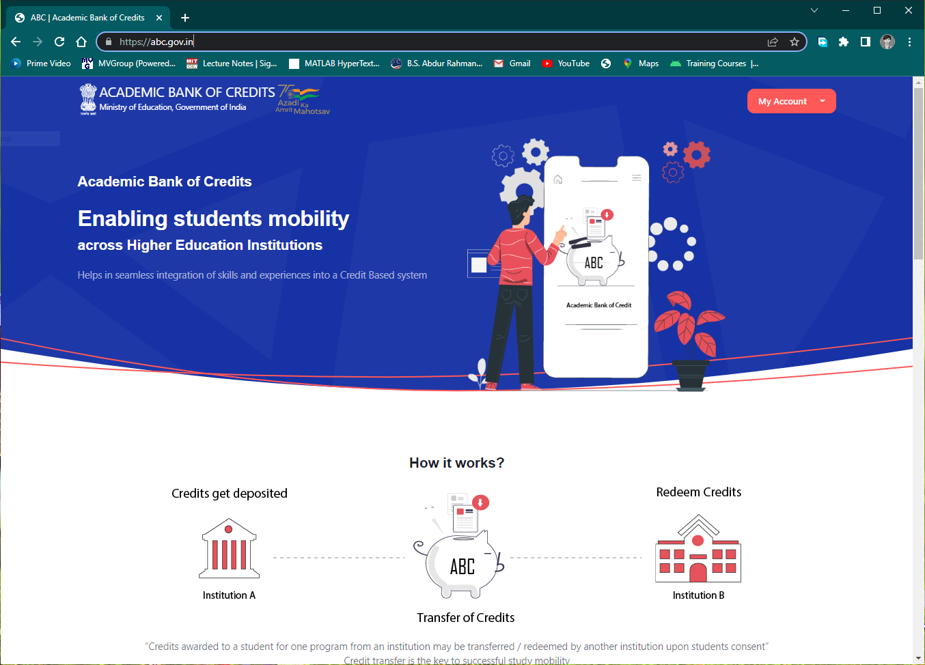
STUDENT REGISTRATION
Step-by-step guide
The students of Vivekananda Global University, Jaipur are eligible to register themselves in the Academic Bank of Credits (ABC) Portal, using their DigiLocker ID.
Step 1
For Students Registration, Open the link https://abc.gov.in in your browser.
Note: The student should have already registered in DigiLocker-NAD before proceeding. In case if the students is not registered himself with DigiLocker-NAD please refer here.
Vivekananda Global University, Jaipur

Slide 5
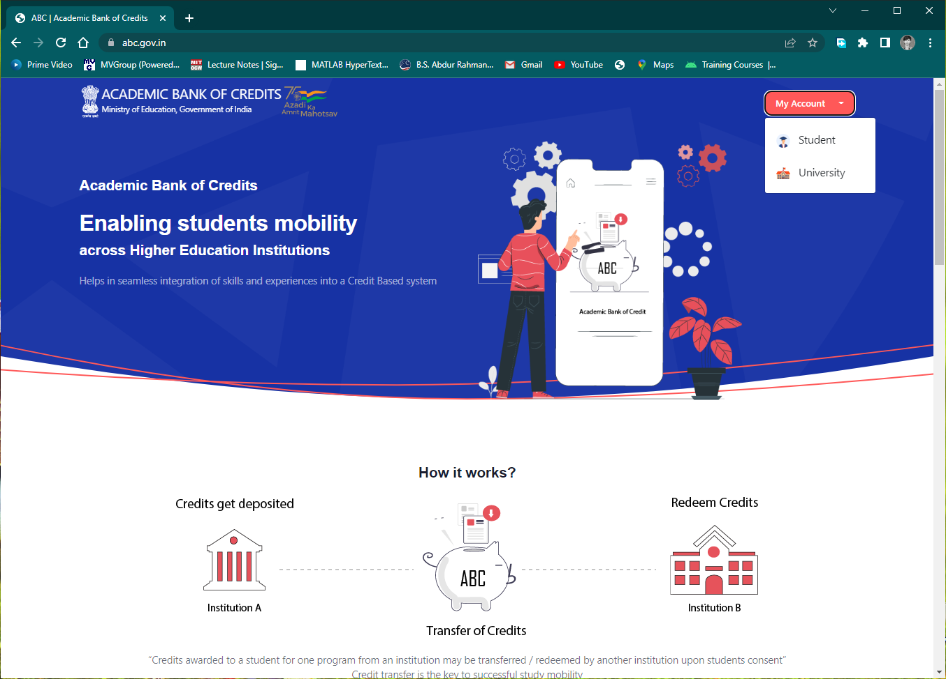
Step 2
Under My Account drop-down select Student
Vivekananda Global University, Jaipur

Slide 6
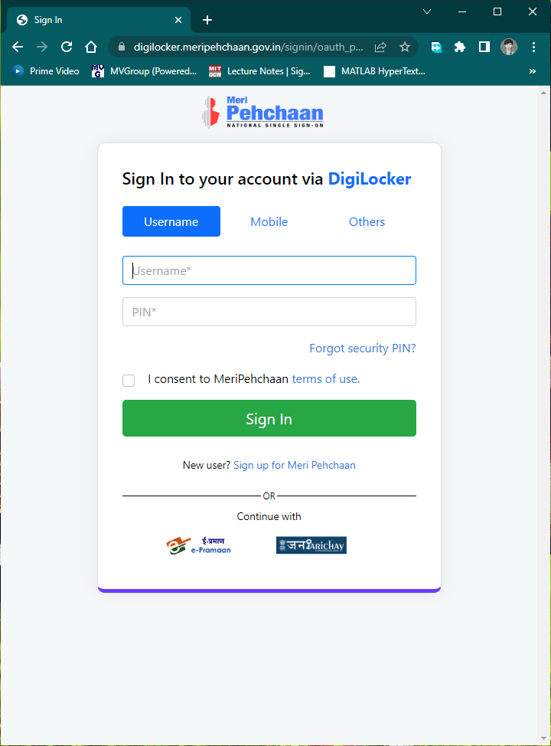
Step 3
Use your DigiLocker Username & Security PIN to login. You can also login using your Mobile number or Aadhaar ID, that was used to register with DigiLocker.
Vivekananda Global University, Jaipur

Slide 7
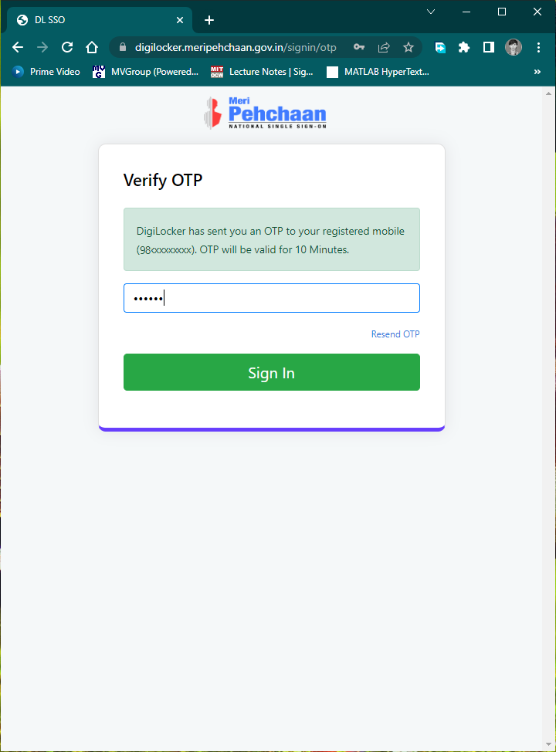
Step 4
Enter the OTP received in your mobile phone and click Sign In
Vivekananda Global University, Jaipur

Slide 8
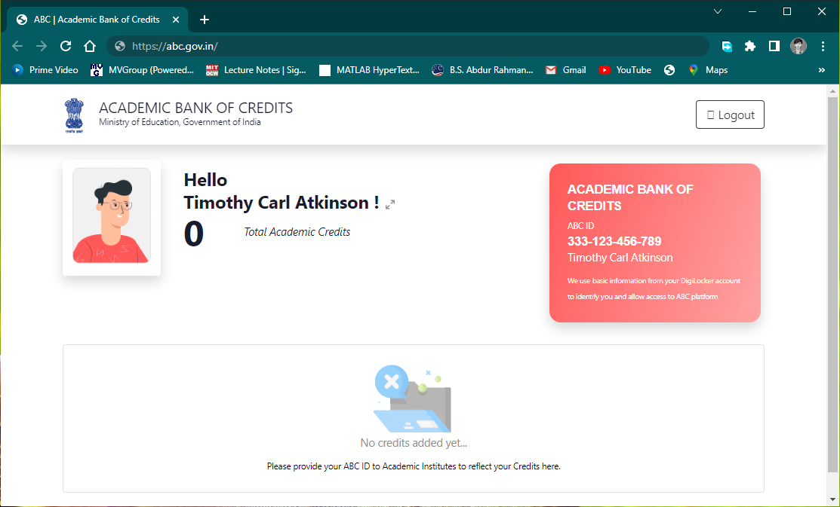
Vivekananda Global University, Jaipur
Registered Successfully
If you get this screen, you have been successfully registered with the Academic Bank of Credits.
Note down your ABC ID (12 Digit ID) and produce it to the concern authorities of your University whenever required.

